Slide 1
Of Whom We Hold Dear
KatzeCat Studios
-Matthew Allum
-Aaron Mulligan
-Lee Hatchman
Notes:
Aaron – 4, 6, 7, 10,
Matt – 1, 3, 5, 11
Lee – 2, 8, 9,

Slide 2

About Us
Three man team
Lee – 3D Modeler
Aaron - Game Designers
Matt - 3D Modeler /Coders
Small team for small game

Slide 3
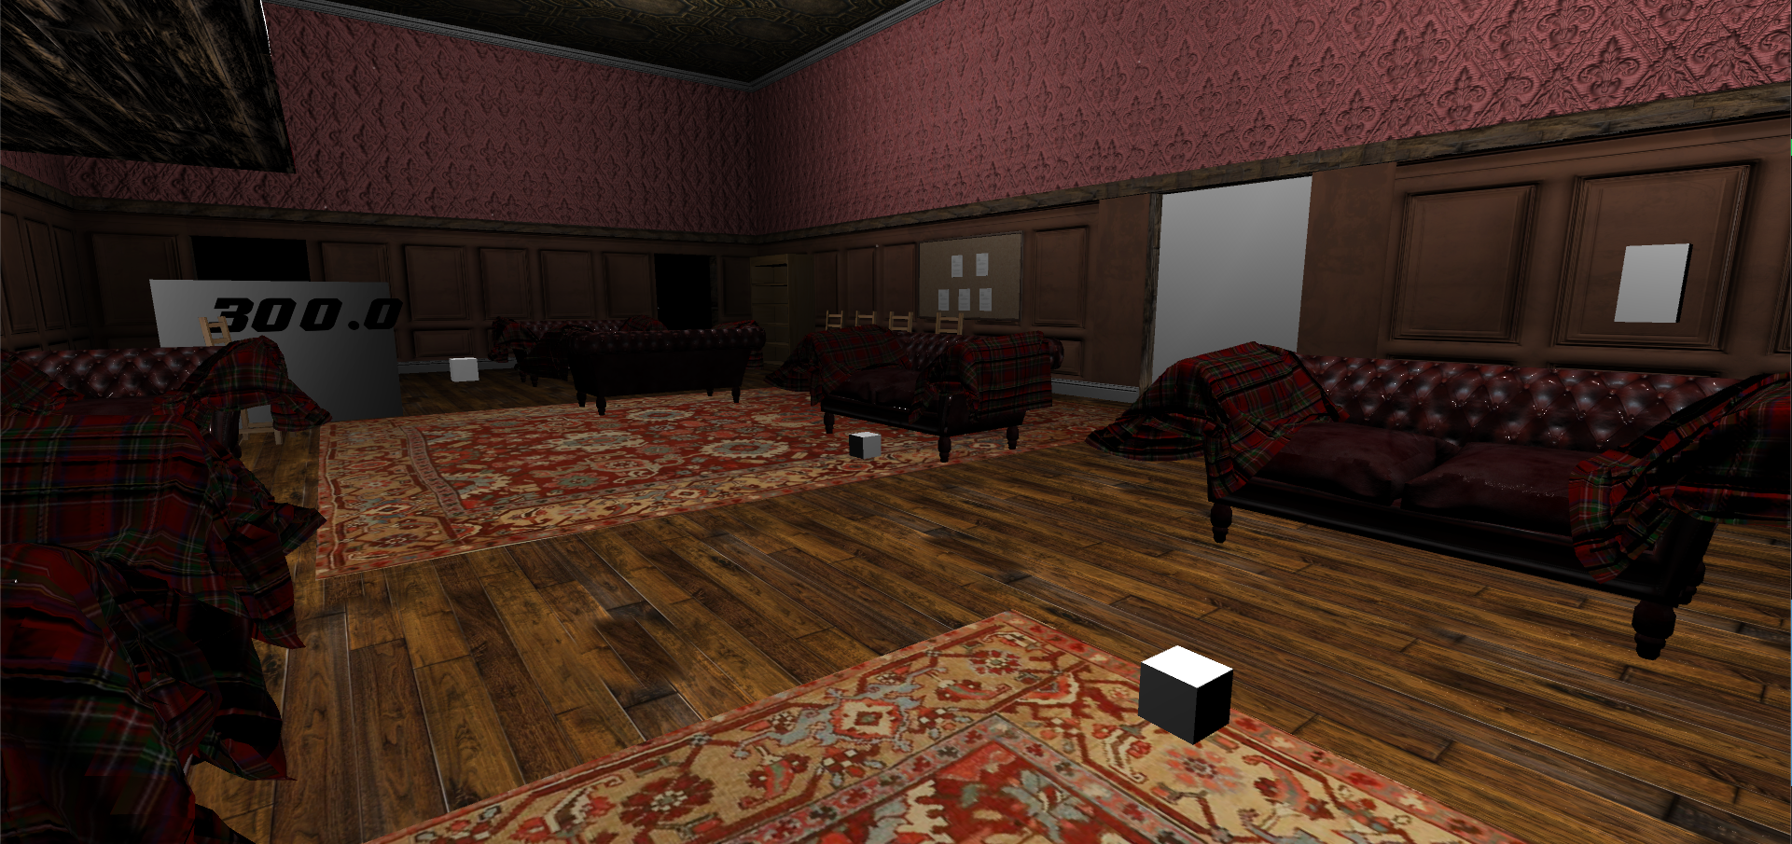
Audience/Logline
Take control and experience an ageing MC struggling with anterograde amnesia. Help him discover what he’s lost and find the truth behind his accident.
PC platform – First person perspective
Teens/Young males ~ females
Notes:
Audience/Logline
We will need to discuss who the character will be (example: Gender, age, anything about them unless we’re making it so the player is the character)
Sporadic productivity, will need to have a definition of what it means for the audience for them to have an understanding of what it means.
Could maybe turn the beginning of the logline into a rhetorical question, example: “Ever wonder what really happens to that one person who holds up a game lobby?”
Following it up with: “Come find out by playing as [character] who suffers from sporadic productivity who must complete menial tasks at the expense of others”

Slide 4
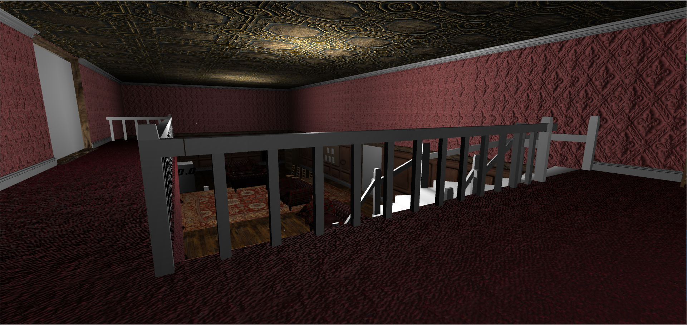
Unique Selling Points
Reverse narrative story (Momento Christopher Nolan)
Make players aware of anterograde amnesia
Innovative game mechanics
(coin fuse box management)

Slide 5
Inciting Incident

Slide 6
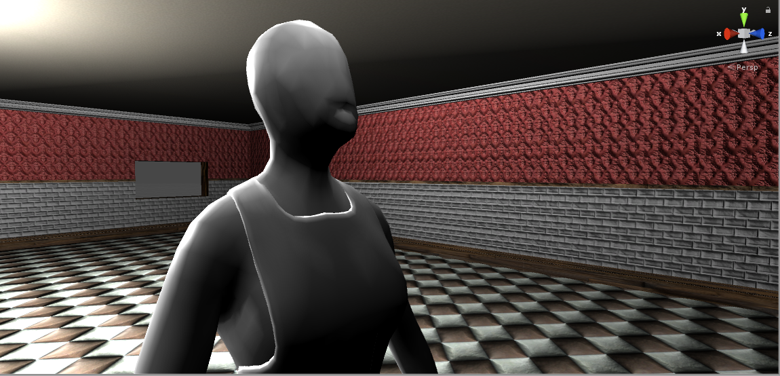
The Carer
Empathetic towards MC – MC fears her
Young, inexperienced, inadvertently scares MC
Only attempts to approach player if
In a puzzle
Fuse box goes out

Slide 7
FuseBox Video

Slide 8
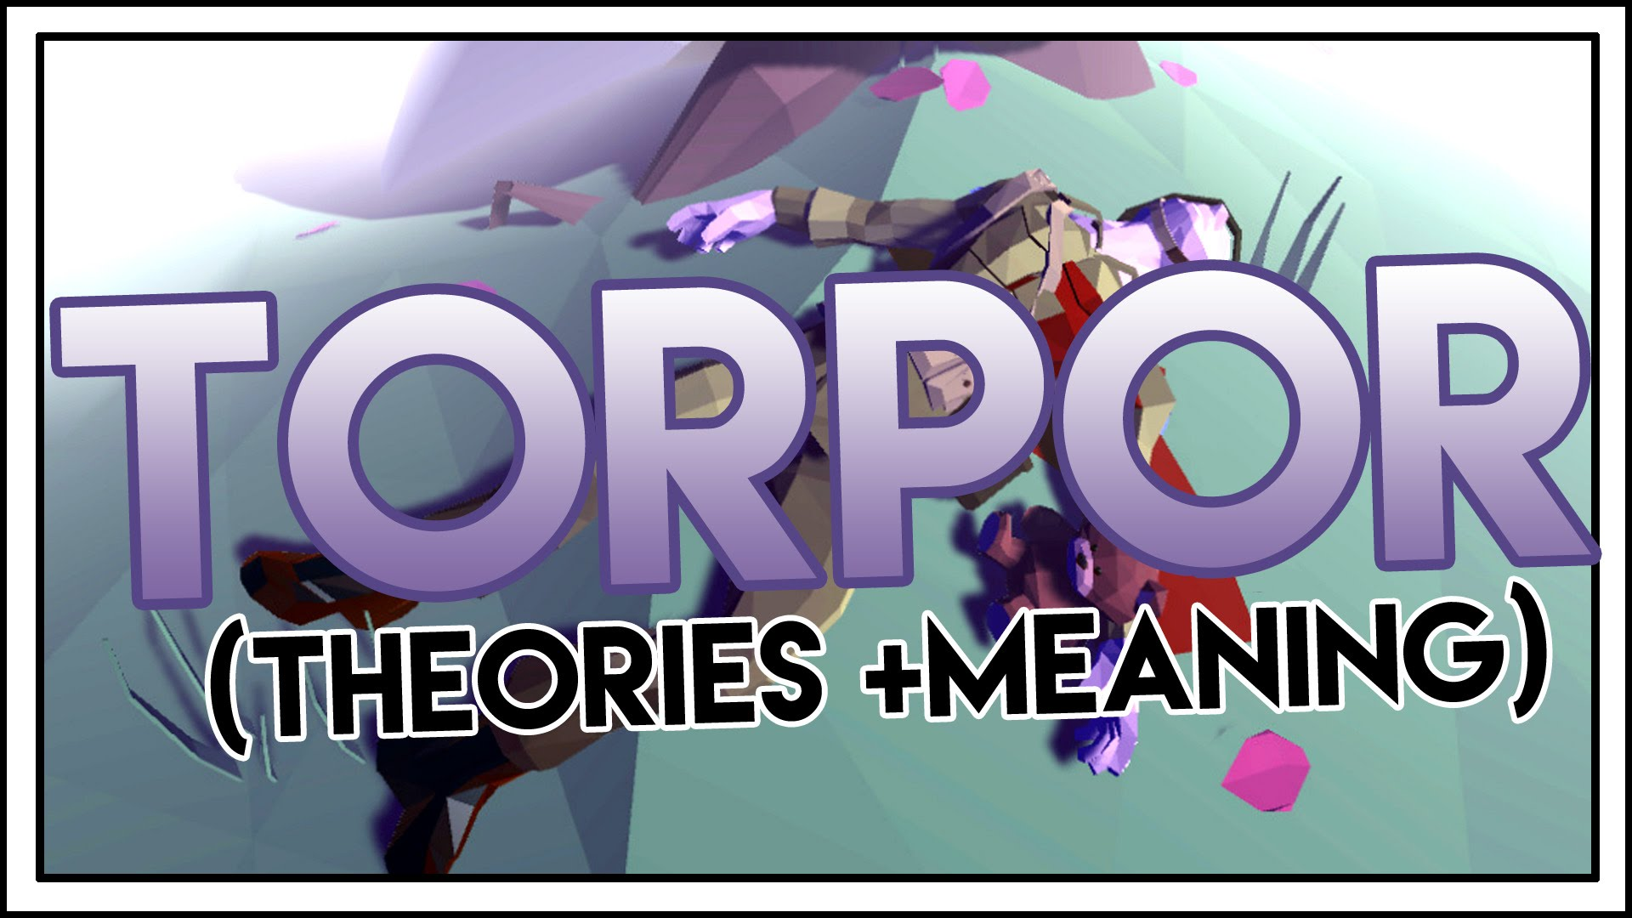
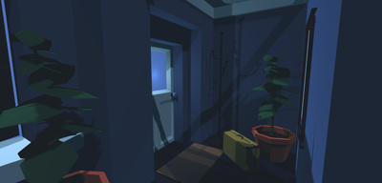
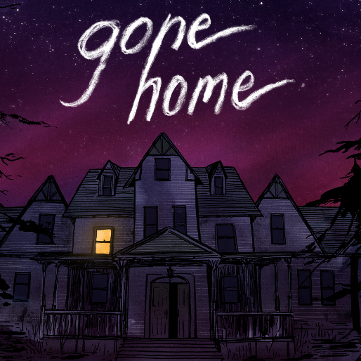
Competition
Torpor (completely free)
Low poly story driven game
Gone Home (sold 250,000 copies - £14.99)
-First Person Exploration game

Slide 9
Puzzle Mechanic Video

Slide 10
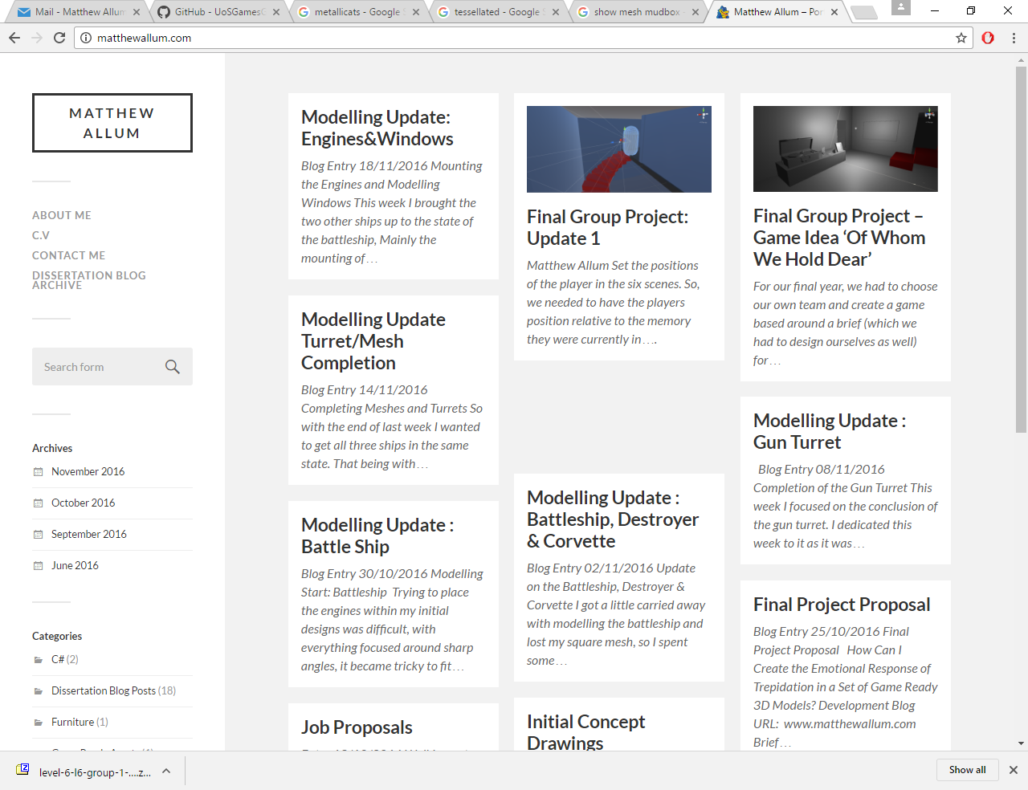
Marketing
Personal Blog posts
Twitter posts
Enterprise Hub Blog Post
Release on Steam Greenlight

Slide 11



Costs
Game price - £5.99
250,000 copies* = £898,500 made (Steam 40% share)
Transfuzer project = initial £5,000 if accepted
License costs covered by the Uni
Voice Actors
Models – All to enhance the enviroment

